Slide 1
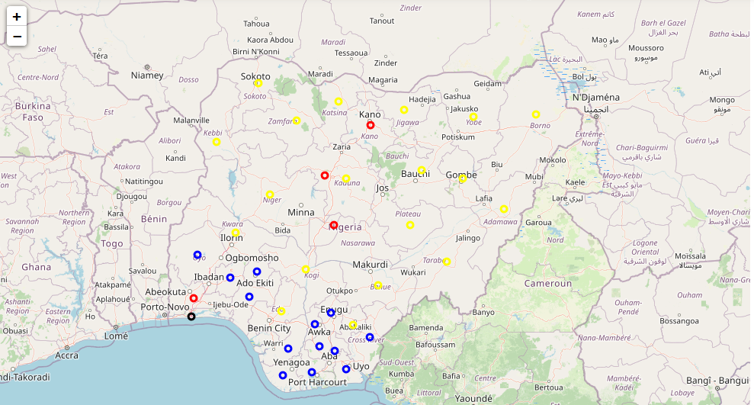
The battle of the neighborhoods
Applied Data Science Capstone
Coursera/IBM

Slide 2

Introduction
Identifying relationship between factors that could affect COVID-19 spread
Deciding locational severity of the virus.
Make recommendation to the government based on obtained results.

Slide 3
Data Acquisition and Cleaning
Data are collected from National Bureau of Statistics, National Centre for Disease Control and Wikipedia.
Location data are collected using GeoLocator and FourSquare API is used to count hospitals around the cities.
Data were merged and the relationship amidst the features are uncovered. Details follow soon.

Slide 4
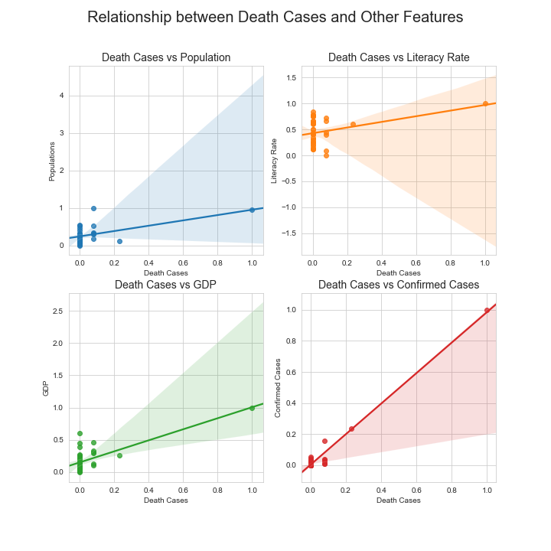
All relationships are positive.
Graph Summarizing Relationship
Between Death Cases and Other
Features
Presence of an outlier.
Majority of the plots are skewed to the left.
Since all relationships are linear, then, Death Cases could be predicted using Linear Regression.

Slide 5
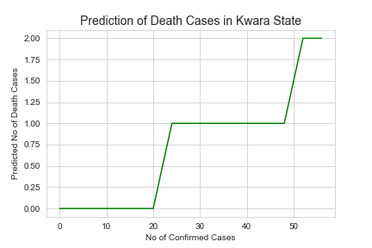
Death Cases Prediction Model
The prediction model was deisgned and experiemented over a range of values.
The best model is a polynomial of degree,
n = 1
THE MODEL EQUATION
y = 0.01989 + 0.98777a + 0.13314b - 0.11411c - 0.04046d
where y = Death Cases, a = Confirmed Cases, b = GDP, c = Population,
d = Literacy Rate

Slide 6
CLUSTERING OF STATES BASED ON COVID-19 REPORT
Color Code:
BLACK = Extreme
RED = Serious
BLUE = Developing
YELLOW = Trivial
Graphical Representation of Clustering result based on the COVID-19 statistics and the demographics of each state.

Slide 7
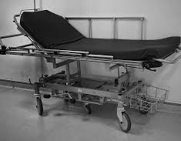


Recommendations
Restrictions on travelling to states with mild cases (Yellow Cluster).
1
Restrictions on movement to curtail the spread in states with developing cases (Blue Clusters).
2
Provision of facilities and restrictions on movement and commerce on states with serious cases (Red Clusters).
3
Total movement lockdown, deployment of health facilities and many medical equipments to Lagos State (Black Cluster).
4

Slide 8

Thank you
Olanrewaju Farooq
Olanrewajufarooq@yahoo.com

